Slide 1
Date-a-Scientist
Dr Sam Norton (who incidentally is a scientist)

Slide 2
Study Questions
Can a persons religious views be predicted by simple social parameters?
Can income be predicted by the same social parameters and the addition of a persons religious standing?

Slide 3
Can a persons religious views be predicted by simple social parameters?
The modern world leads to considerable overlap between different cultures and religions
Where previously religion often dictated local social behaviours, there is now a melting pot of religious views and social behavior
Here I tested whether drinking culture, drug use and sexual orientation could predict an individuals religious standing.

Slide 4
Religious views were simplified for ease of analysis
Nuances in the ‘quality’ of belief were removed for each religious group.
A new column called “religions_simple” was created to contain these values
For example:
“catholicism and laughing about it” becomes:
“catholicism”
for i in range(len(religions)):
if 'catholicism' in religions[i]: religions[i] = 'catholicism'

Slide 5
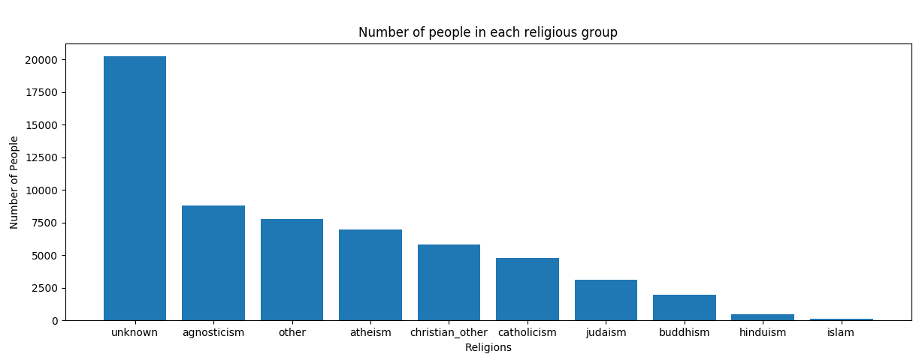
Agnosticism was the most prevalent religious belief of people who recorded a value

Slide 6
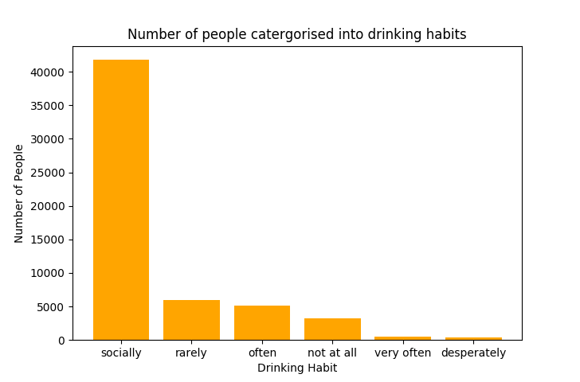
All social parameters were numerised in the same manner
Drug use, drinking culture and sexual orientation were converted to a numeric code system and assigned new columns
For example: For drinking - "not at all” = 0, "rarely” = 1, "socially” = 2, "often” = 3, "very often” = 4, "desperately” = 5

Slide 7
Two classification methods were used to determine whether religious standing could be predicted by social parameters
Support Vector Machines(SVM)
KNearestNeighbours(KN)
This approach was considerably faster than the SVM model
10 iterations of KN, with different K values, completed faster than a single iteration of SVM
It also provided a higher accuracy and F1 score than SVM
Accuracy = 0.30
F1 score = 0.07
These scores are very low and therefore indicate an inability to predict religion based on these social parameters
While the accuracy would suggest the model is better than guessing (1/10) the F1 score does not support this.

Slide 8
Can a persons religious views be predicted by simple social parameters?
From this dataset, it would appear that religion cannot be predicted by drinking culture, drug use and sexual orientation
Including more of the social parameters within this dataset may however have altered this result
More categorical data on social values would greatly improve the relevance of this broad question to real life
A cohort of people that more evenly represent the religious groups would be more appropriate for answering this question
Some religions have much stricter ‘rules’ regarding these parameters

Slide 9
Can income be predicted by social parameters and a persons religious standing?
Whether we like it or not, there is an unofficial “class” system in most western societies
And different social cultures often arise within these “classes”
Further, in some societies there are still unfortunately prejudices towards certain religious groups when it comes to employment – NOT GOOD.
Here I tested whether simple social parameters and religious standing could predict a persons income.

Slide 10
The simplified religious view points were numerised
All social parameters were numerised as with the previous objective
In addition, the simplified religious parameters were also numerised and a new column created called “simple_religions_code”
This was created using the same approach as the social parameters.

Slide 11
Two regression methods were used to determine whether income could be predicted bysocial parameters and religions standing
Both models required very little time to run
Multiple Linear Regression (MLR)
This approach had an accuracy of 0.004
Not very accurate at all
K-Nearest Neighbours Regression (KNR)
This approach had an accuracy of 0.12
Which is considerably better than MLR but still not great
This approach was probably better suited to this question given that the parameters were categorical rather than being continuous data.
It is unlikely that there would be a linear relationship between any of the social categories and income

Slide 12
Can income be predicted by social parameters and a persons religious standing?
From this dataset, it would appear that income cannot be predicted by drinking culture, drug use and sexual orientation
Many of the individuals in this cohort did not disclose their income, this would have greatly impacted our ability to train the model
A next step could be to follow up some of these members and request their income
The parameters used to predict income were all categorical – further social data of a continuous nature would potentially be better suited for answering this question.

Slide 13
THANKS FOR THE COURSE!
I learned a lot!! Just want to know the best way to put perceptrons together now!!

